Slide 1

Patient services
Name: Jessica Williams
Experience: 13 years of direct patient care as a Practitioner both military and civilian.
Goal: Improve patient experience to increase facility Hospital Consumer Assessment of Healthcare Providers and Systems (HCAHPS)

Slide 2

Agenda
Data Dictionary & Tools:
3 Excel Workbooks, 124 Columns, 457,764 Rows
Link to Github
Google, MS Teams, Word, PowerPoint, Excel, Power BI, Power Automate, MS Forms
Problem
Improve Patient Services Tracking
Ratings
Hospital Consumer Assessment of Healthcare Providers and Systems (HCAHPS)
Solution
Patient Experience Survey
Q&A
Thank you for your time!

Slide 3

Problem
Collection data method
Inefficient data collection process for analyzing
Time-consuming
Expensive and requires additional resources
Limited accessibility

Slide 4
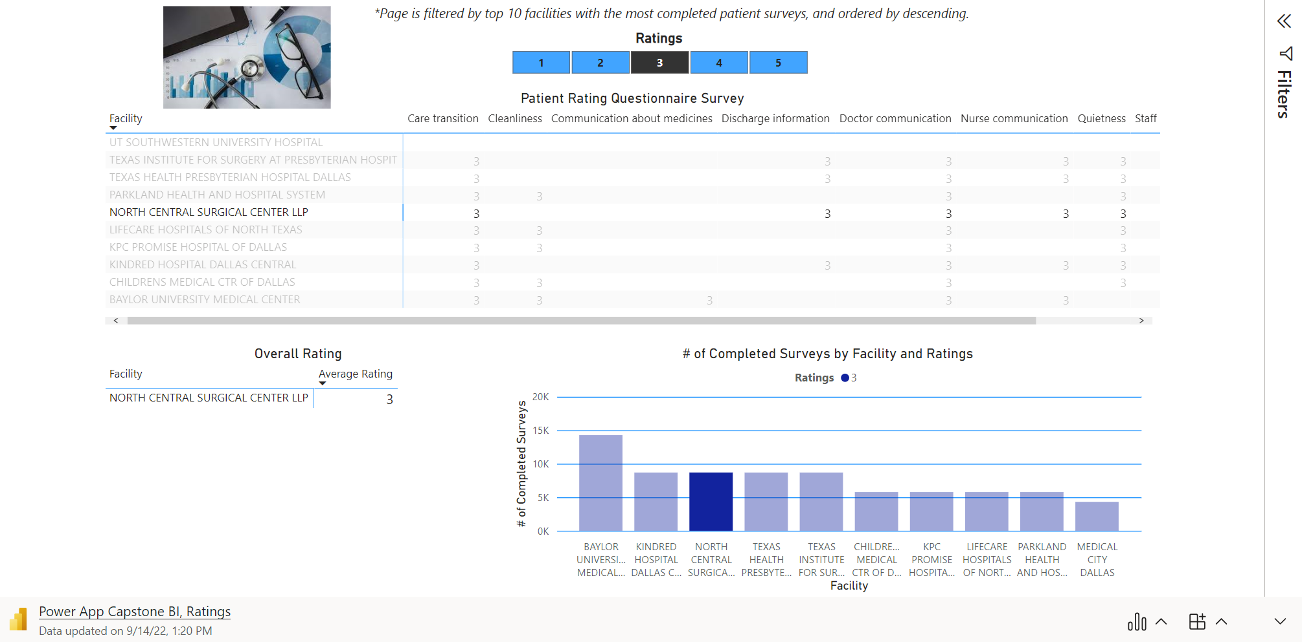
Ratings

Slide 5
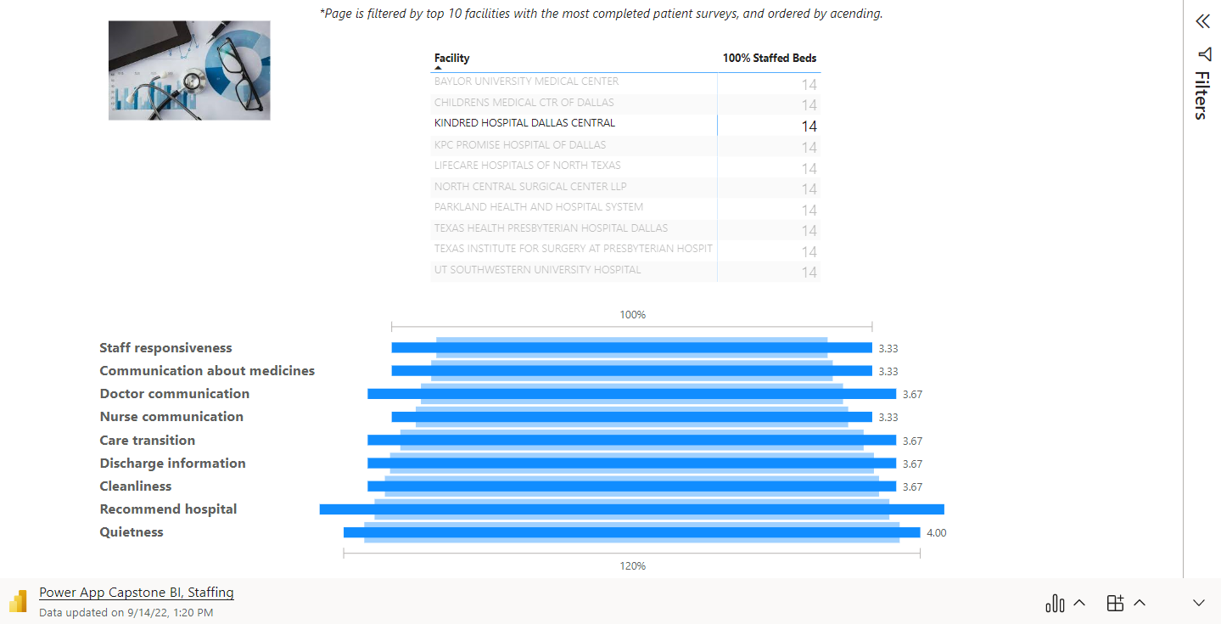
Ratings – Overall by section

Slide 6

Solution
https://forms.office.com/r/X4Q7mz49qL

Slide 7

Thank you for your time!
Q & A

